Slide 1
Website Redesign
Design Guidelines

Slide 2
How to use this document
These rules apply to every page of the site. Each rule is about one part of a page, such as the header, a button, a card or a carousel. Follow the rule wherever that part appears, on the homepage or deep in the site.
1. Site-wide rules hold on every page. Fonts, headline colours, black in place of dark navy, secondary colours as accents, pill and circle buttons, the outlined button family, photography in place of icons, no ellipsis, the header and the footer.
2. Rules for a part of a page hold wherever that part appears. The homepage shows each one once. Feature cards, regional cards, content cards, carousels, the media wall, video, the results tiles and the news list. A page that uses one of these uses it as shown here.
3. The wireframes set what goes on a page and in what order. This document sets how those parts look and behave. Where the homepage design changed something from its wireframe, such as the Why Families carousel or the six region cards in a grid, the change is the rule from here on.
4. Anything new follows the same rules. Where a page needs something the homepage does not have, for example an FAQ list, numbered steps, the school search with its map and filters, charts and tabs, people cards or a row of partner logos, design it to these rules and mark it as new when the page comes to Uncommon for review.
5. If the homepage design and this document disagree, follow this document.

Slide 3

Header
1. Taller header. Slightly taller than the wireframe, giving the logo and the navigation more room.
2. Larger logo. The Uncommon Schools logo is larger for a stronger brand presence at the top of the page.
3. Rounded bottom corners. The header sits as a shape over the hero image.
Header over the hero photo

Slide 4

Hero
1. Dark tint on the photo. The hero photo carries a dark tint so the white headline stays readable over any image.
2. Calmer type. The headline and supporting text are set smaller than in the wireframe, so the photo carries more of the weight.
3. Find a School stays in the hero. Locked up with the headline and supporting text, so the first action a family needs is visible on arrival.
Homepage hero

Slide 5
Announcement bar
1. Yellow bar. Matches the Find a School card, so announcements are noticed at a glance.
2. Arrows cycle the announcements. Several announcements, shown one at a time.
Announcement bar under the hero

Slide 6
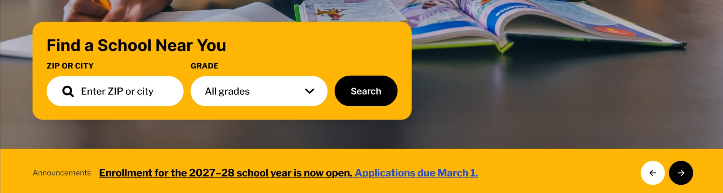
Feature cards
1. Yellow background, white selectors, black button. Feature cards like the Find a School card use this combination.
2. Yellow over blue. Yellow adds vibrancy and energy where we want the eye to go.
Find a School card in the hero

Slide 7


Headline colours
1. Two colour pairs. White and yellow on dark backgrounds. Black and blue on light backgrounds.
2. The second colour highlights the key words. Yellow on dark sections, blue on light sections.
3. Supporting text. White on dark backgrounds, black on light backgrounds.
Dark background: white and yellow
Light background: black and blue

Slide 8

Headline type
1. Section headlines: Knockout 49 Liteweight.
2. Section supporting text: Libre Franklin Medium.
3. No ellipsis in headlines. The example on the right shows the one thing not to copy.
Knockout 49 Liteweight. The ellipsis is not used.

Slide 9


Colour
1. Black, never dark navy. Whenever a dark colour is needed, use black.
2. Secondary colours as accents. Where possible, use secondary colours from the brand guidelines to add a touch of variation, never in a significant way.
Black section background
Secondary colours as accents in the media wall

Slide 10


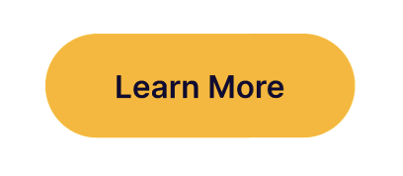


Buttons
1. Calls to action are pills. Always pill-shaped and one height, so they read as one family across the page.
2. Secondary calls to action are circles. The arrow buttons on cards and carousels.
3. Outlined family. The footer buttons, the menu button and the carousel next button use outlines, drawn thicker so they read at a glance.
Primary: black pill and menu circle
Yellow pill with icon
Yellow pill
Secondary: outlined circle
Secondary: previous and next

Slide 11
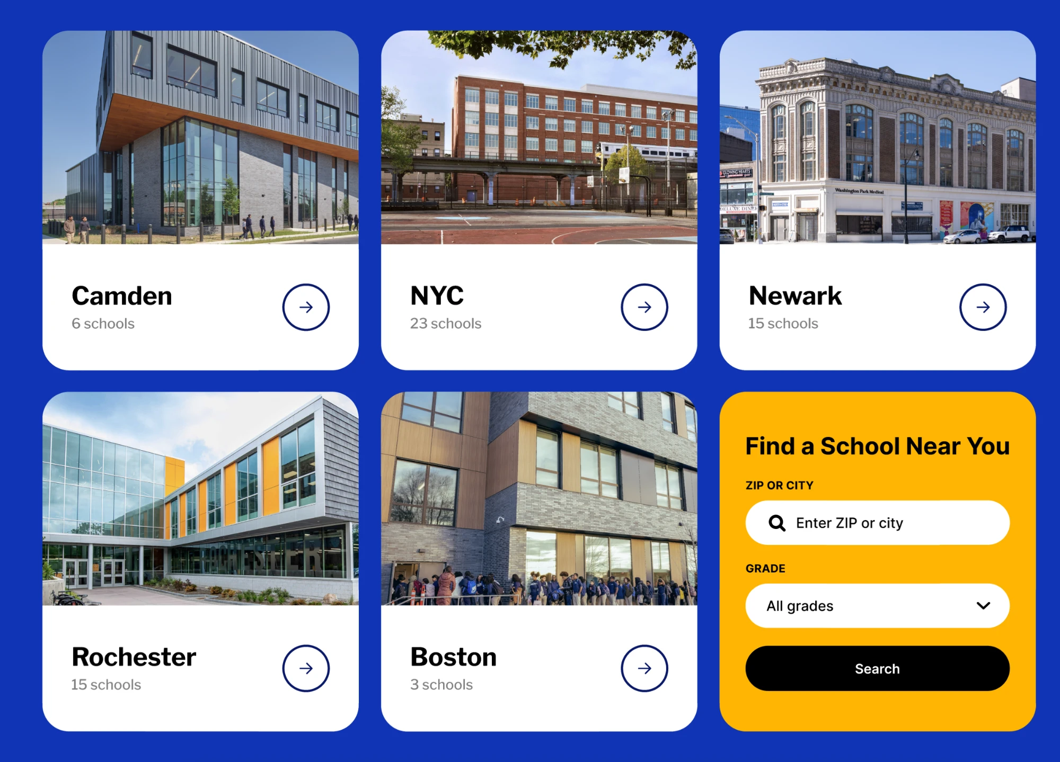
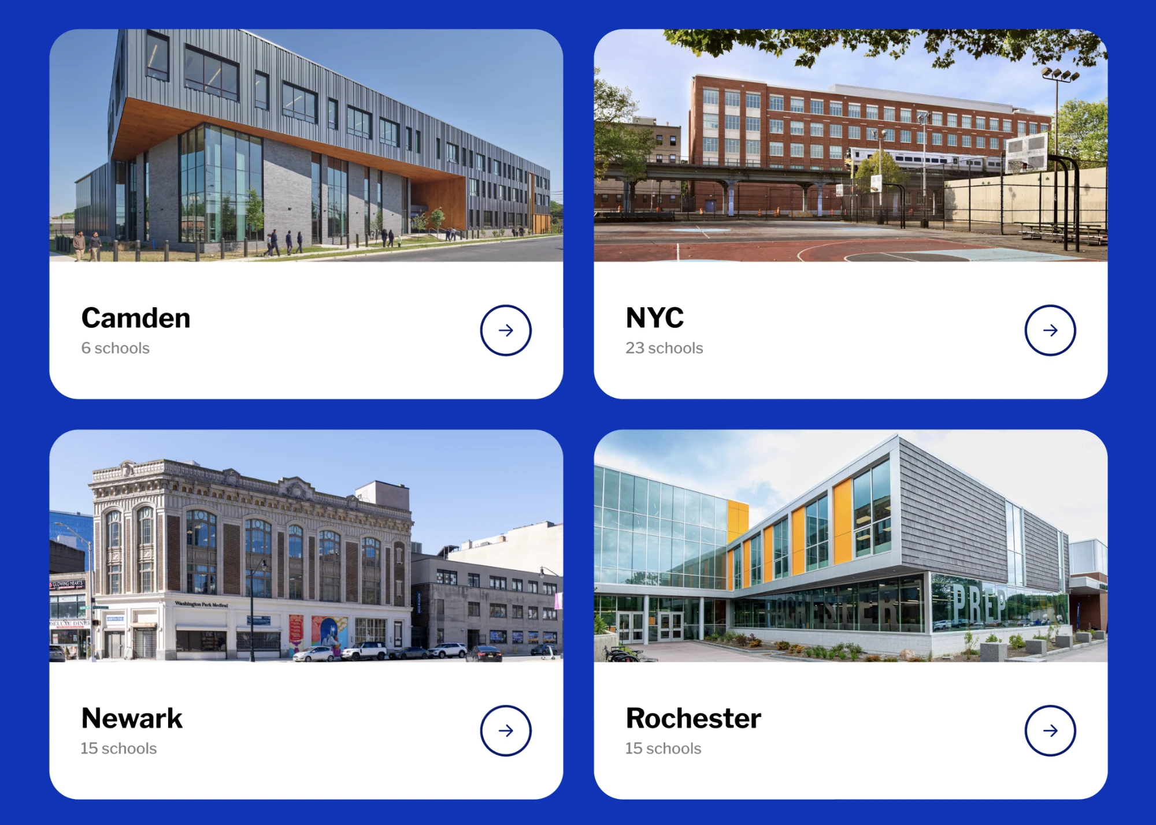
Regional cards
1. Columns of three or two. Regional cards are displayed in either.
2. Find a School pairs with the group. The card sits with the regional cards, as the sixth card in a grid of three.
3. Always the circle arrow. Regional cards always use the circle secondary call to action.
4. Each card holds a school exterior photo, the region name, the number of schools and the arrow.
Three columns, Find a School as the sixth card
Two columns

Slide 12
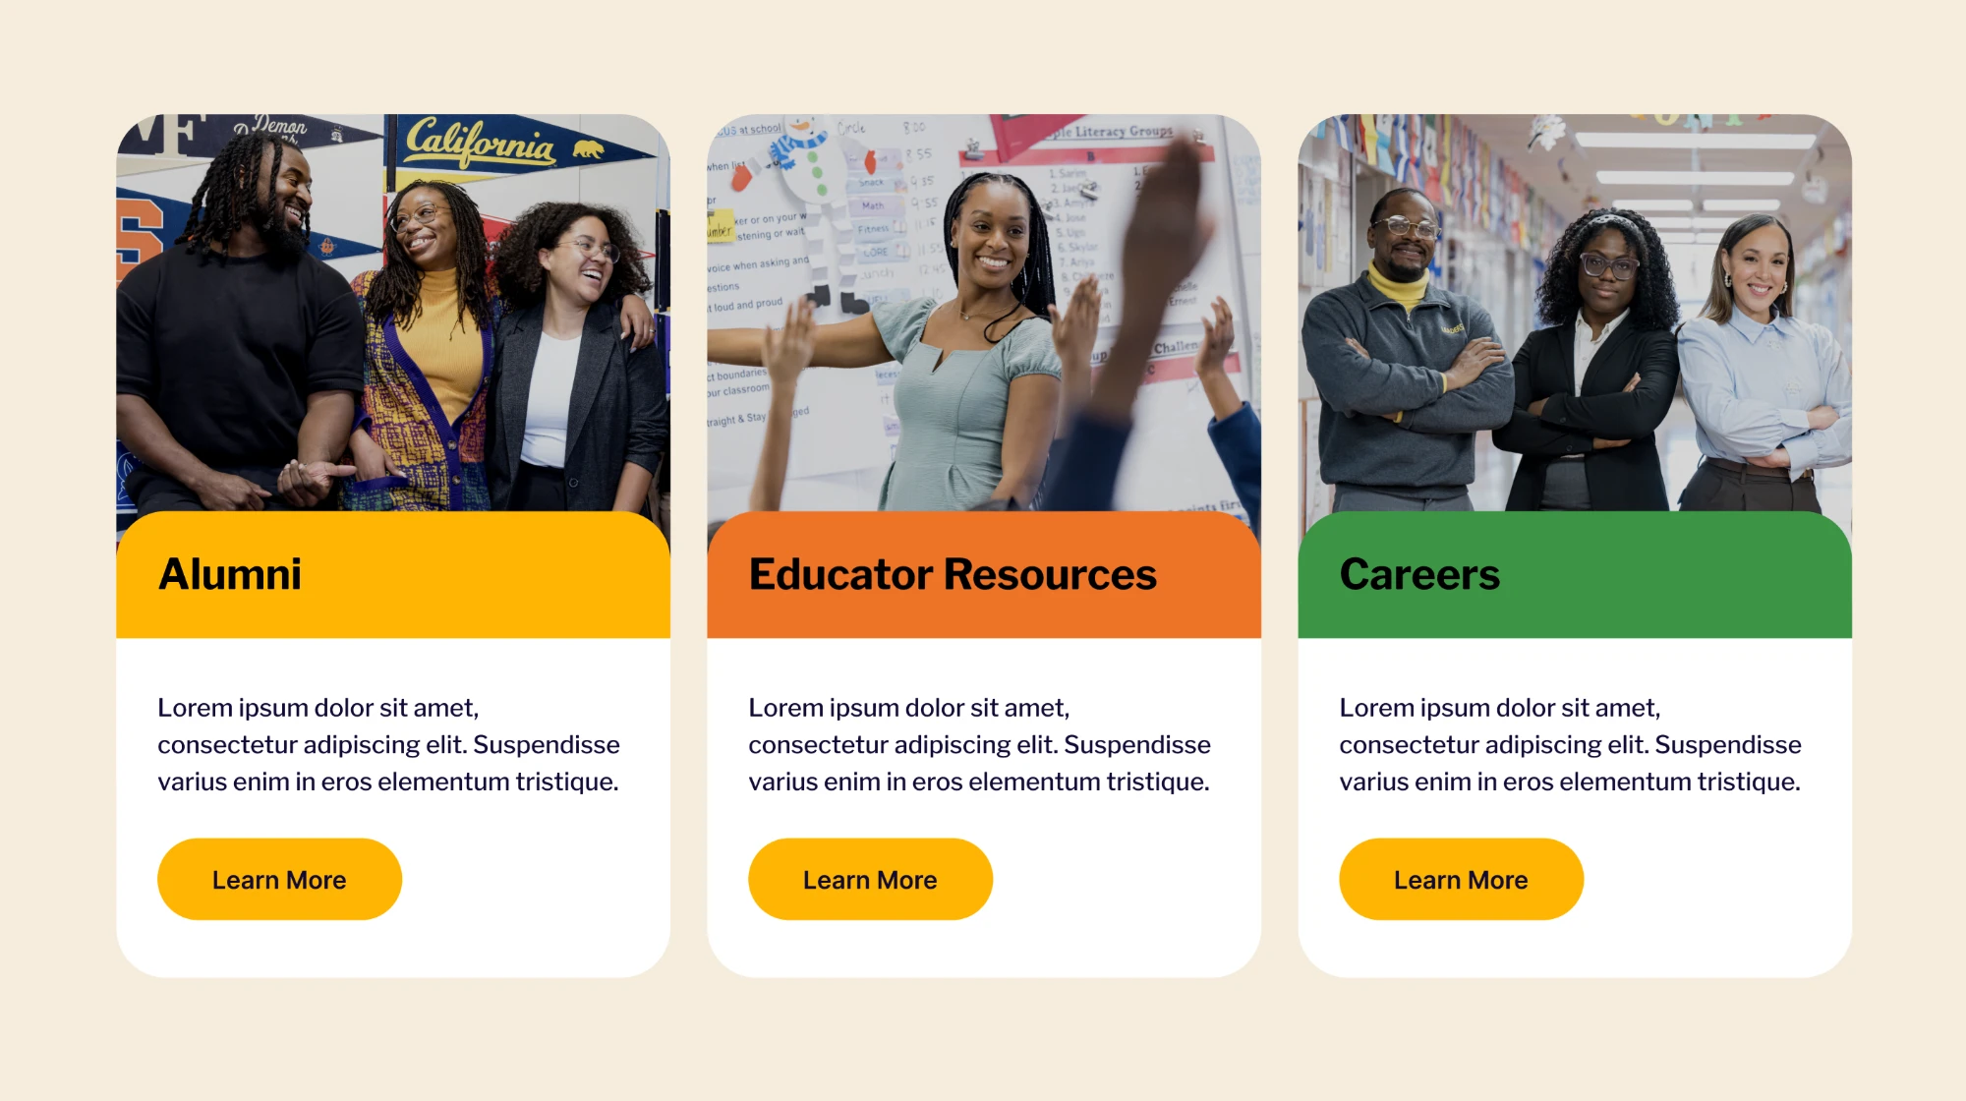
Content cards
1. Photography, not generic icons. Icons feel generic and add no emotion or connection to a card.
2. Colourful accent shapes and designs carry the card instead, like the coloured title bands.
Your Connection cards

Slide 13

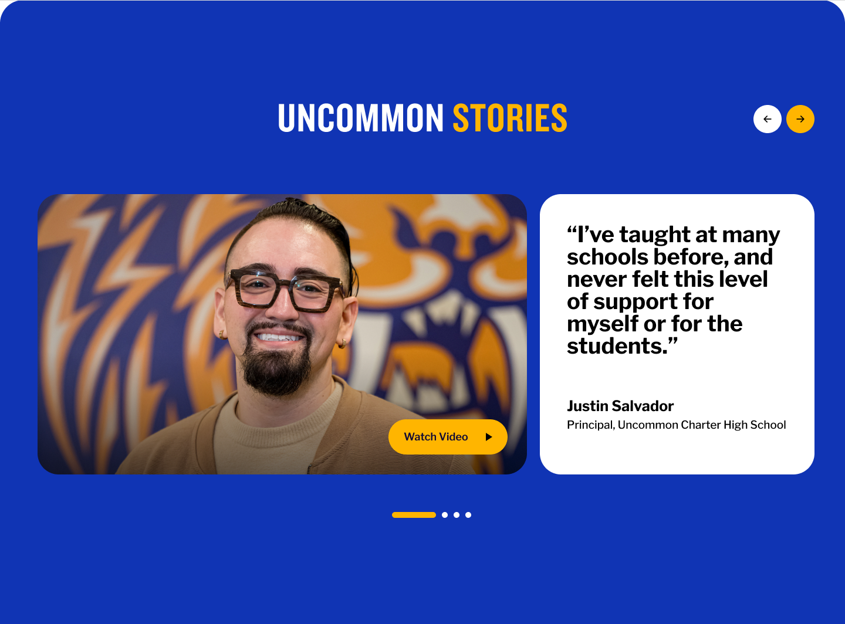
Carousels
1. Why Families is a slide carousel, not an accordion. Each pillar is one slide: a blue card with the title, copy and button, paired with a photo. The next slides peek out behind the active one. The three pillars are Rigorous Academics, A Community That Knows Your Child, and Private-School Quality, Tuition-Free.
2. Uncommon Stories is a carousel of stories. Arrows and dots move between them. The quote card names the person and their role.
3. The next button is the outlined circle of the card arrows, not a solid button with a Next label.
Why Families Choose Uncommon Schools
Uncommon Stories

Slide 14


Photo and video
1. Media wall. The mission statement is a grid of photo tiles with openings for single-word brand descriptors. Each tile cycles through two or three images; each descriptor can cycle through a set of words.
2. Video. The thumbnail beside Joyful opens a lightbox that plays the brand video. The story card plays a short looping clip until Watch Video is pressed, which opens the full video.
Media wall
Video card

Slide 15
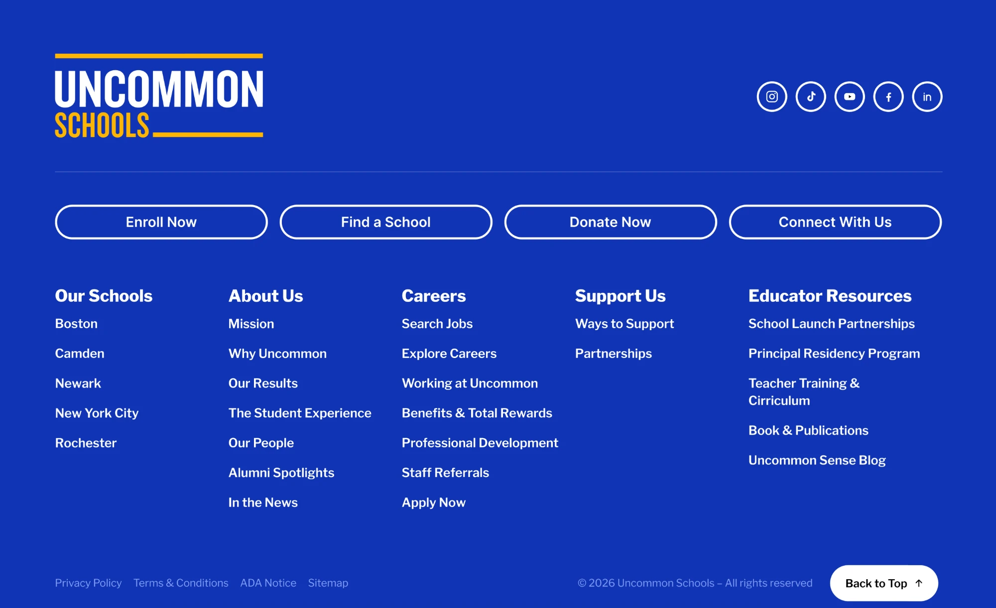
Footer
1. The footer of choice. Brand blue, logo top left, social icons top right, four buttons, five link columns, legal links and Back to Top along the bottom.
2. Four outlined buttons. White stroke outlines, never filled or coloured.
3. Five columns. This column orientation is the choice from the variations provided.
Footer

